Slide 1
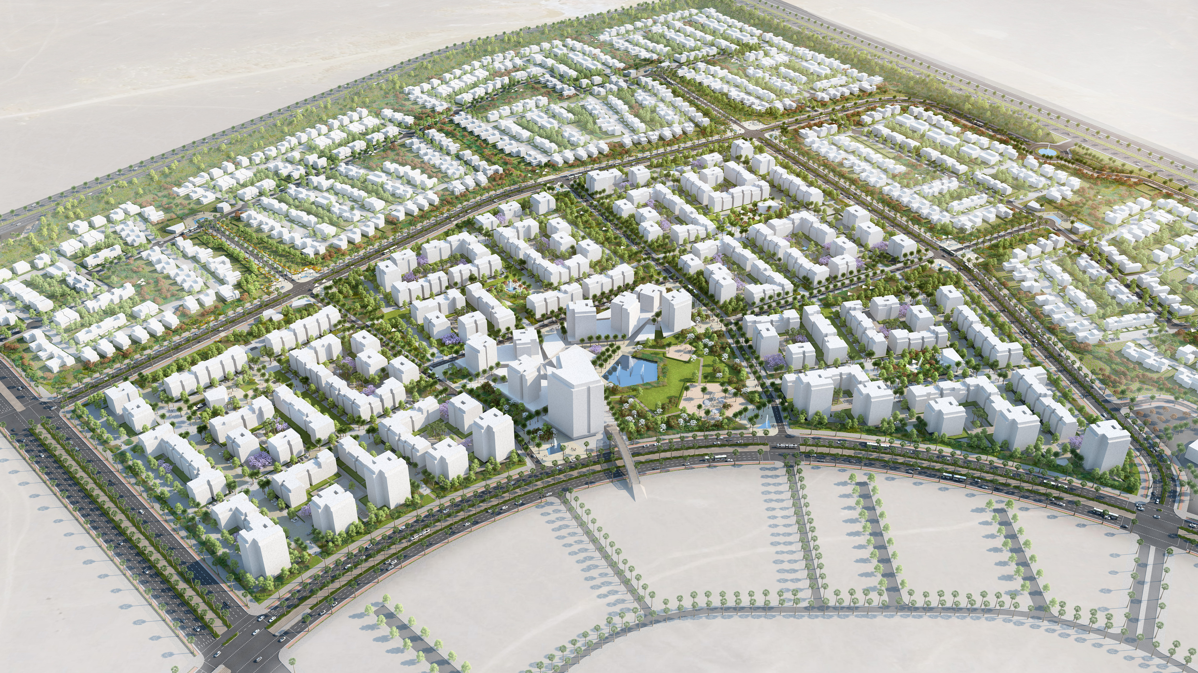
BADYA– New Beginnings
6th of October City I Stage 3 Report – 29.03.2018

Slide 2
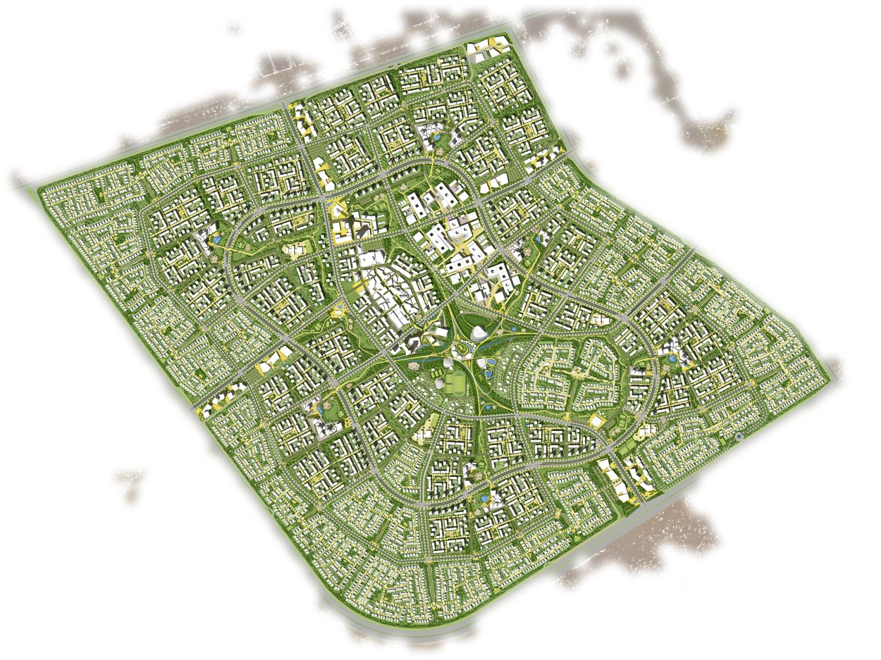



The Masterplan
Consultants
AS+P – Albert Speer + Partner
GmbH
Architects, Planners
Frankfurt
https://www.dreso.com/en/
http://www.as-p.de/
Date
March 2018
Frankfurt am Main/ Germany
http://www.julius-berger-int.com/en/
https://www.aecom.com/

Slide 3
Site Connection
Non-Residential & Special Land Use

Slide 4
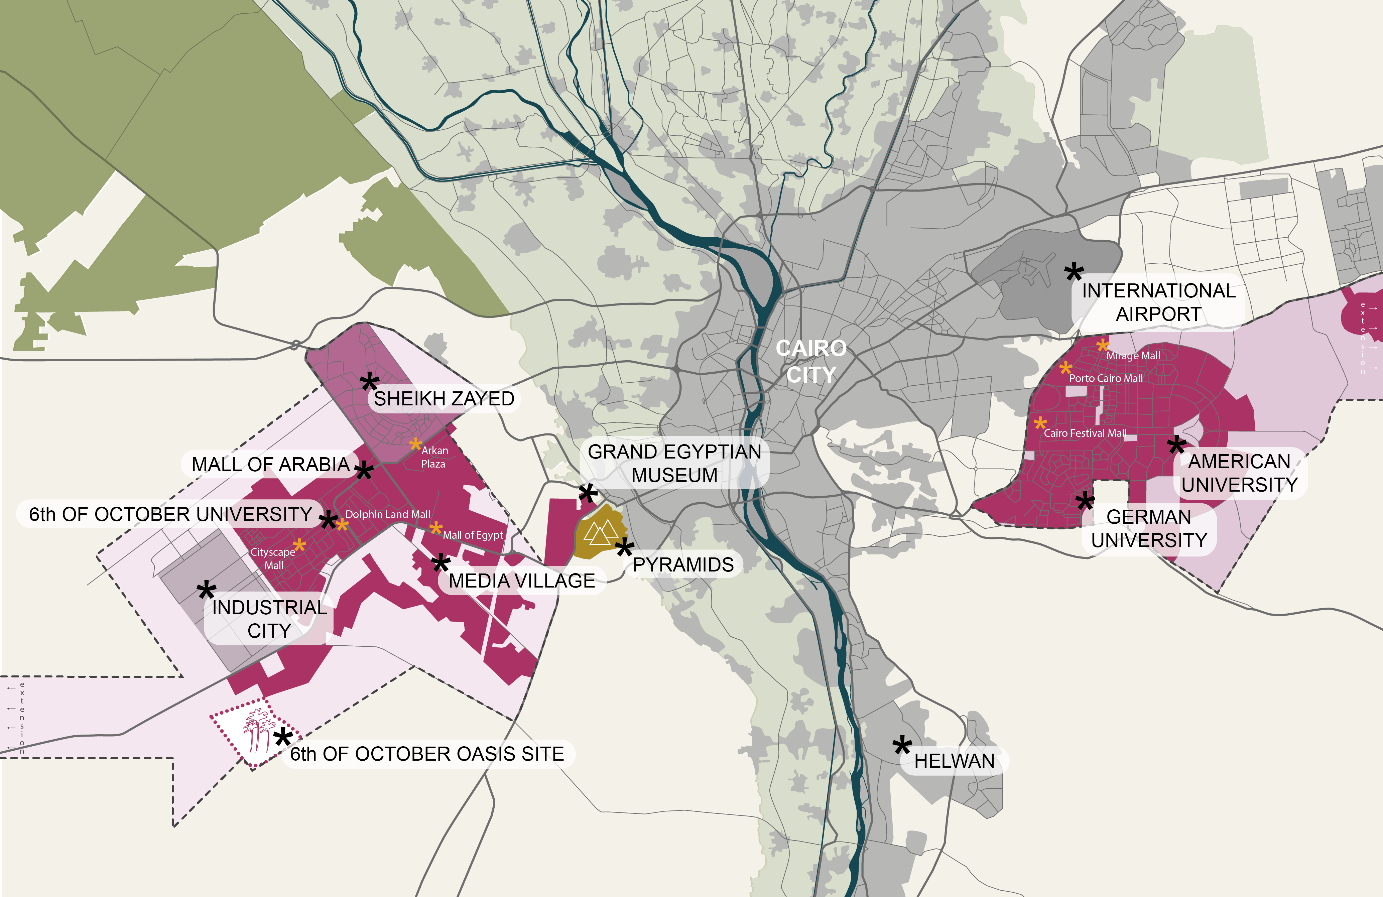
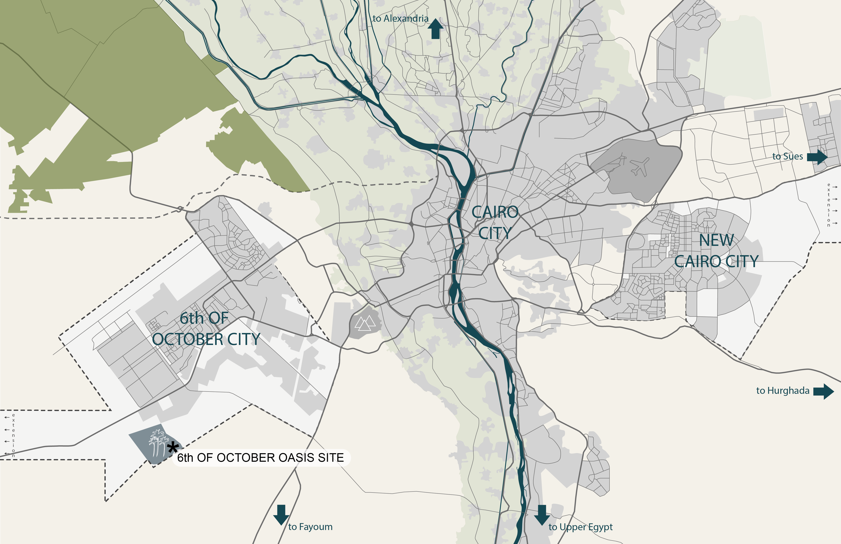
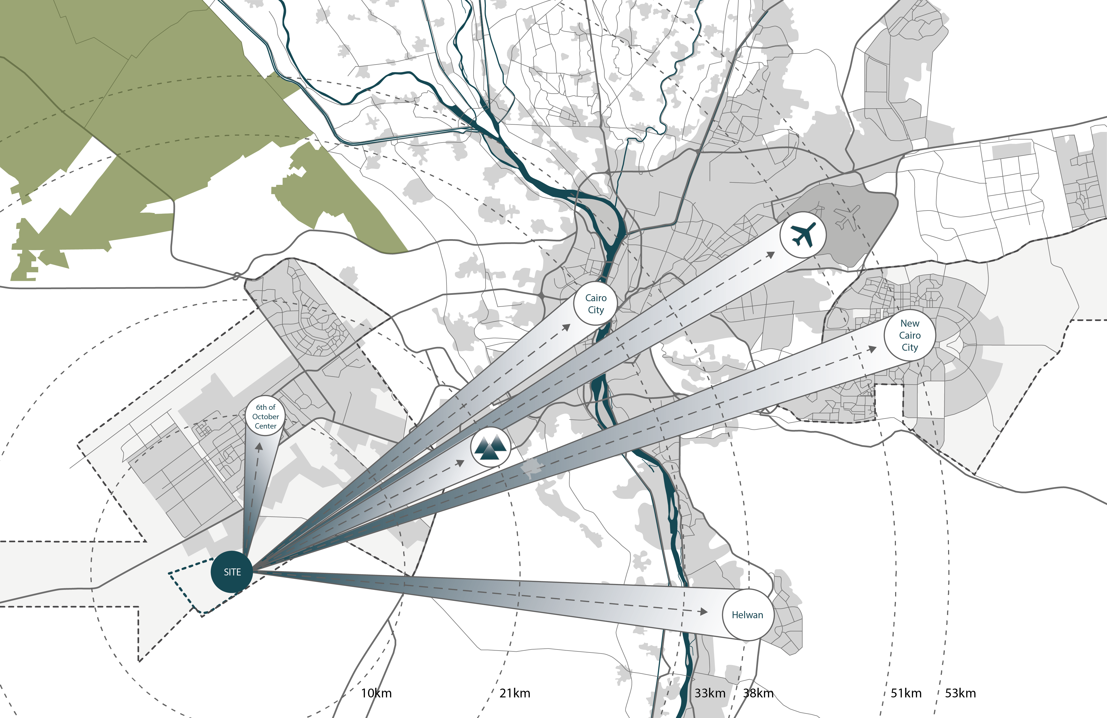
Site Location within wider Context
01 Surroundings Analysis
The 6th of October Badya Site is located at the south-eastern edge of the 6th of October City, the largest new urban community west of Cairo.
It lies approximately 10 kilometres from the 6th of October City Centre, 20 kilometres from the Giza Pyramids and about 30 kilometres from Central Cairo.
The surrounding area to the east and the south of the site is currently undeveloped desert land but in centre of the new strategic masterplan for the overall development of the 6th of October City.
NUC’s in the surrounding area
Site location within wider context
Distances from site

Slide 5
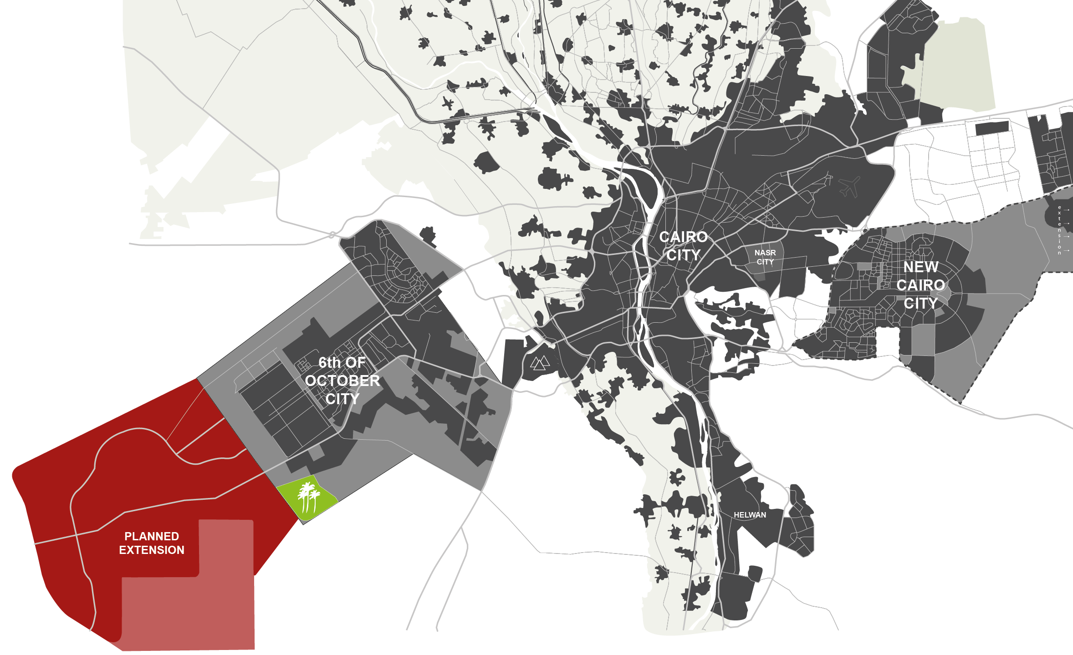
Future Developments Surrounding Site
01 Surroundings Analysis

Slide 6
Future Developments Surrounding Site
01 Surroundings Analysis

Slide 7
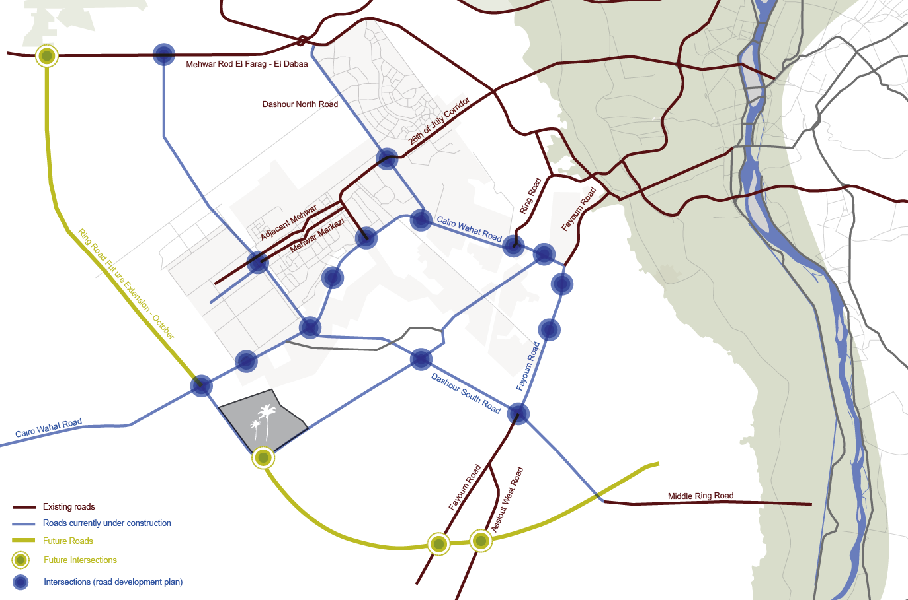
Current + Future Connections to Site
01 Surroundings Analysis
Motorways in the west and the south of the Badya site are part of the 6th of October ring road which connects the site to central Cairo, the pyramids and the airports
The highway along the southern edge of the site is currently already under construction
The requirement for an additional expressway along the northern boundary of the Badya site has been acknowledged by the NUCA
Arterial Roads will connect the Badya site to the surrounding neighbourhoods

Slide 8
Current + Future Connections to Site
01 Surroundings Analysis
Motorways in the west and the south of the Badya site are part of the 6th of October ring road which connects the site to central Cairo, the pyramids and the airports
The highway along the southern edge of the site is currently already under construction
The requirement for an additional expressway along the northern boundary of the Badya site has been acknowledged by the NUCA
Arterial Roads will connect the Badya site to the surrounding neighbourhoods

Slide 9
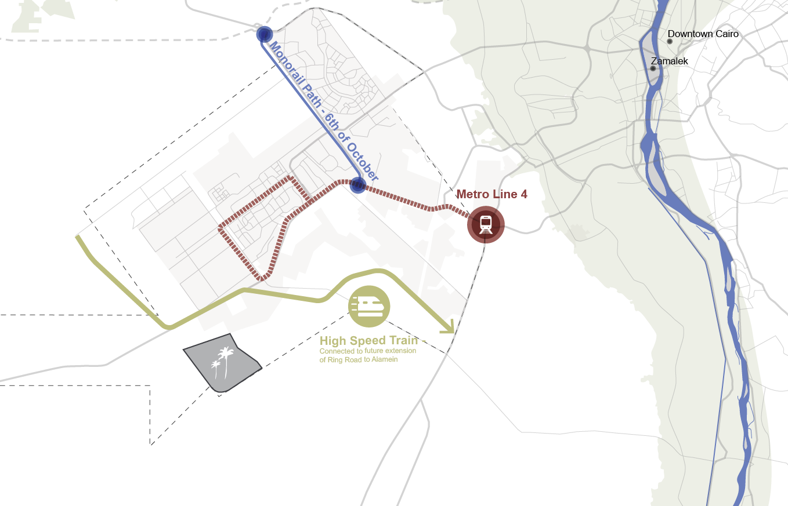
Public Transport Connections
01 Surroundings Analysis
Metro Line 4 –Monorail – BRT – High Speed Train
Extension of planned line
Approx. 45 km (30-45 min to Central Cairo (e.g. Sadat Interchange to line 1 & 2)
Metro: Fastest and most convenient mass transit
Only acceptable connection for commuters (Max. 1 hour travel time, max. 1 interchange)

Slide 10
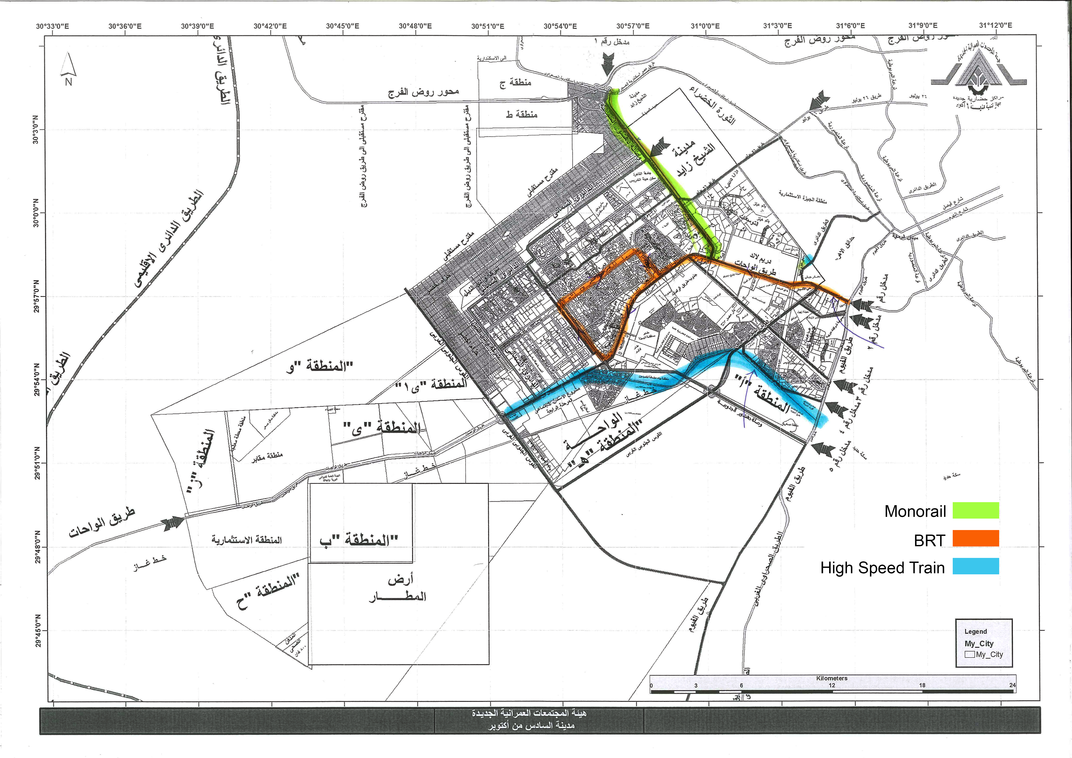
Public Transport Connections
01 Surroundings Analysis
Metro Line 4 –Monorail – BRT – High Speed Train
Extension of planned line
Approx. 45 km (30-45 min to Central Cairo (e.g. Sadat Interchange to line 1 & 2)
Metro: Fastest and most convenient mass transit
Only acceptable connection for commuters (Max. 1 hour travel time, max. 1 interchange)

Slide 11
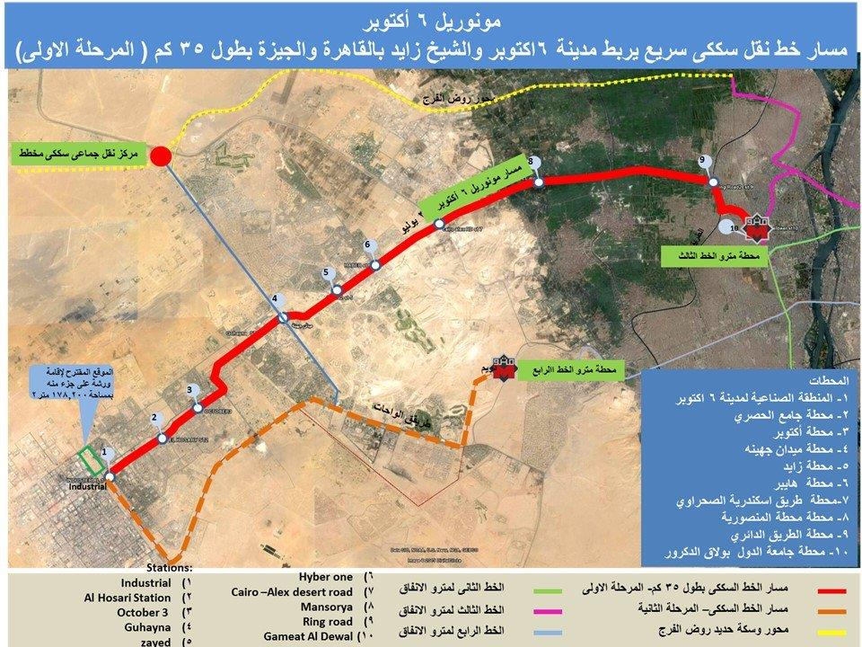
Public Transport Connections
01 Surroundings Analysis
Monorail

Slide 12
Site Connection
Non-Residential & Special Land Use

Slide 13
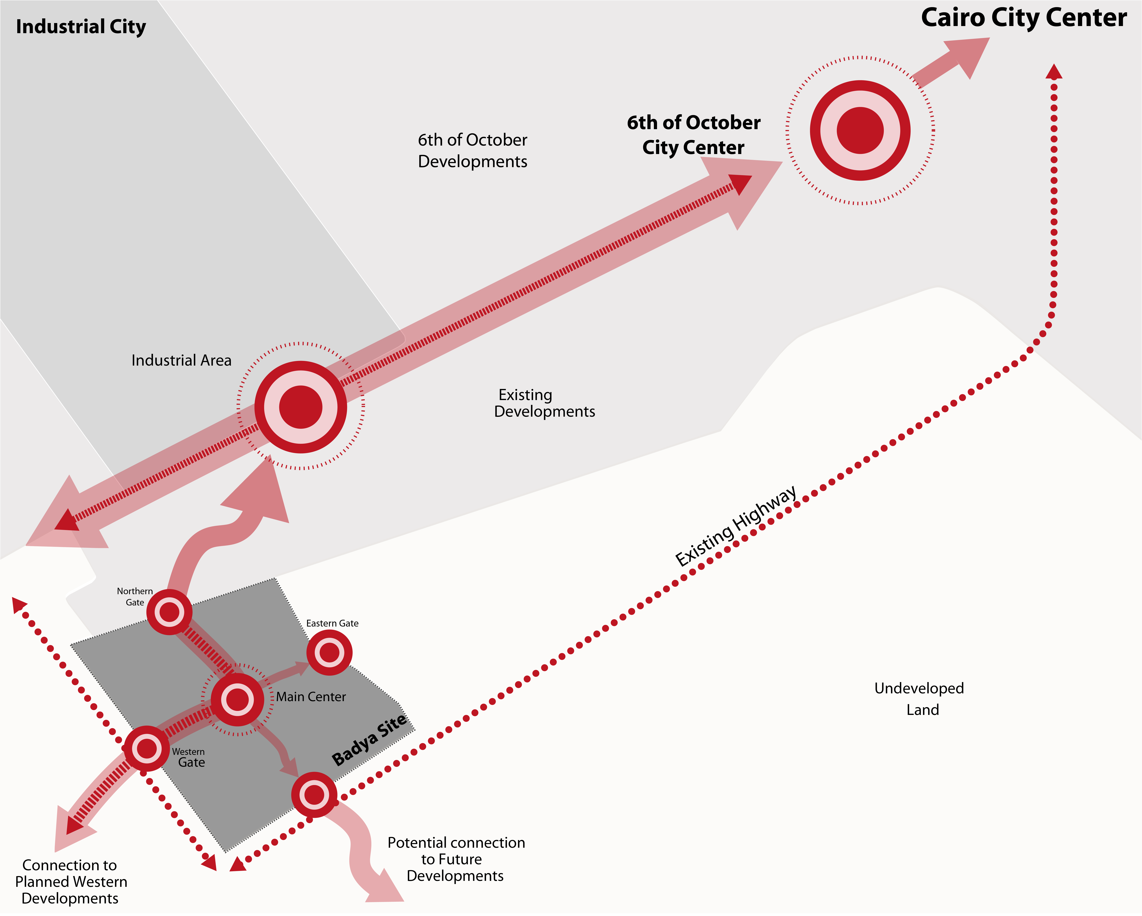
Centre Development Approach
03 Design Principles
Large retail and commercial spine leading from the entrance of the 6th of October City to the city centre
City centre of the 6th of October City still holds a great development potential
There is potential to connect the future centre of Badya City to the existing centre structure in the 6th of October in order to generate an integrated commercial area and to take advantage of synergies
Ensure a strong connectivity through a decentralised centralisation approach and efficient connections on site
A well designed, high class centre on the Oasis site could fill a gap in the existing commercial offers and attract customers from compounds outside Badya City. This could have a positive effect on the commercial revenue of the Badya City centre and result in an active urban centre at a relatively early stage of the project
Keep opportunity to connect with possible future developments in the south and in the west
Notes:
City as a node connected to the 1.existing development structure 2.east 3. future – establish own weight first by dev of smaller centres

Slide 14
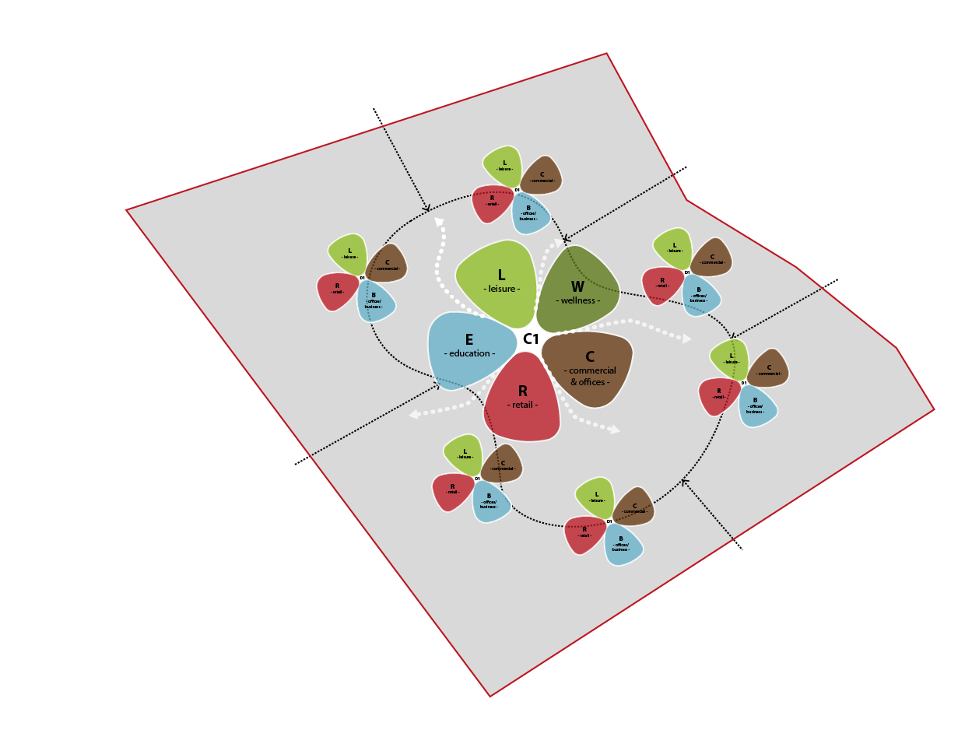
Programming for Urban Center
03 Design Principles
District Centres
Commercial
Retail
Office
Leisure
One main urban core area with large commercial, cultural, administration and office facilities that is adjacent to the university campus and the sports club
Additional mixed-use commercial district centres will be provided in each residential district and neighbourhood to ensure equal provision with everyday goods and social institutions throughout the development
Urban Core
Commercial + Retail
Office
Leisure + Wellness + Sports
University
Cultural + Administration

Slide 15
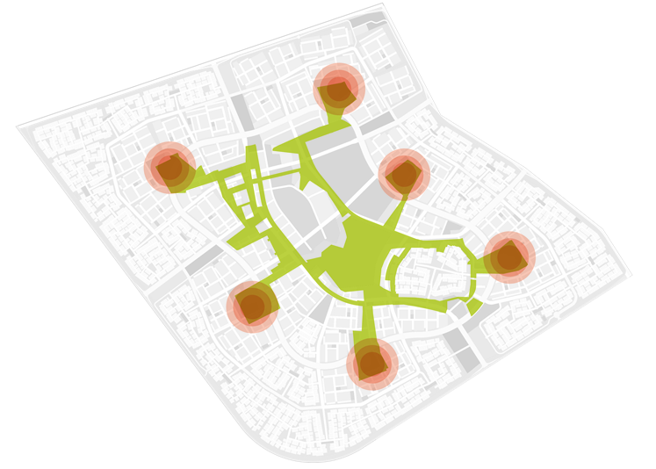
Main Elements forming the Design
05 Masterplan Development
6 + 1
Non-Residential Land-Use Area in Neighbourhood & District Centres
185 Fed – 777,000 M2
Non-Residential Land-Use Area in City Core
175 Fed – 735,000 M2

Slide 16
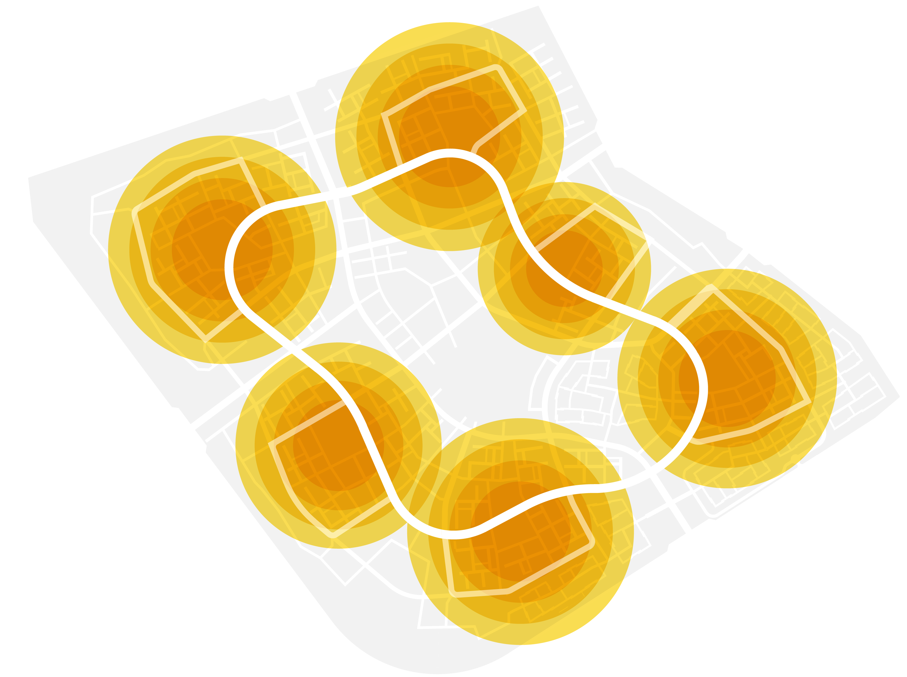
The Districts
05 Masterplan Development
6
6 Unique Districts
There is a total of 6 individual districts with 1 district centre each. Each district is supposed to convey an distinct identity among the residents in order to help create a feeling of community and belonging.
Each district centre features residential towers, commercial and retail in the ground floor as well as office space and administration offices. The centres are evenly distributed in order to provide all residents with easy and comfortable access to these facilities.
Furthermore this district + centre approach enables a logical implementation strategy. Each district can be developed as an independent unit, with local non-residential facilities that serve its residents.

Slide 17
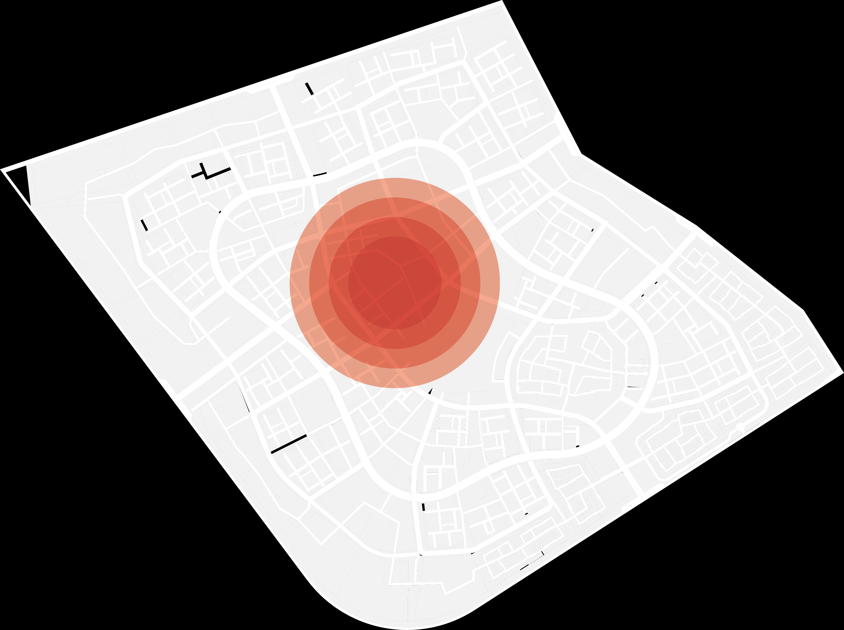
The Core
05 Masterplan Development
1
1 Urban Core
The urban core area in the heart of the development is supposed to become a destination west of Cairo. It will be the commercial, cultural and recreational centre of the development. It features a high quality designed pedestrian zone with outdoor shopping, gastronomy, cultural, recreational and entertainment facilities as well as urban residential areas, office spaces and room for administration buildings.
The core area also features a large university campus and the luxury sports club.
In combination, all these uses form a unique core area that will become a signature landmark of the development and will set it apart from the existing standard desert towns.

Slide 18
District Centre
05.05.2018
– 6th of October Badya
18

Slide 19
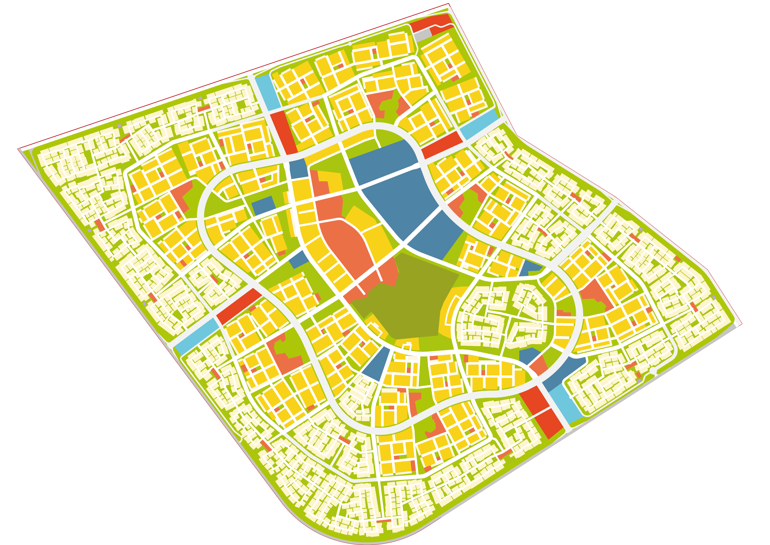
Land Use Plan
06 Land Use Plan + Calculations
Government Mall and Transit Hub
Shopping Mall
Urban Core Area
Apartment Clusters
University
Townhouses
Sports Club
Central Green Oasis
Business Parks
International Schools
District Centres
Villa Compounds
Residential Areas:
47% Villas - 53% Apartments

Slide 20
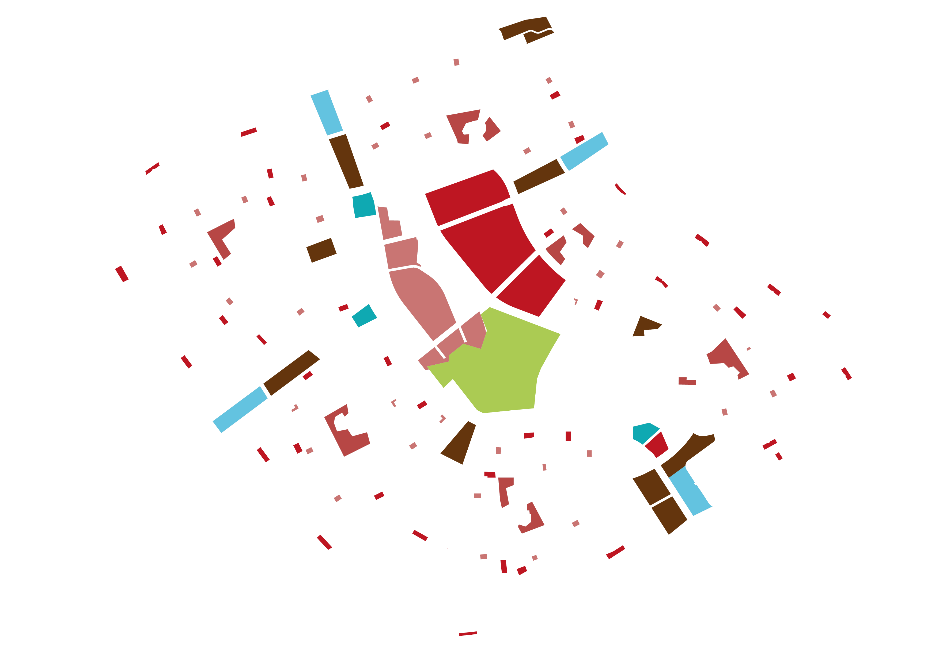
05 Masterplan Development
Special Use Areas
Special Use Areas:
Special Use areas exist throughout the entire development to ensure an even and convenient accessibility of non-residential uses for all residents.
The special use areas have been categorised into facilities of:
daily use (within 5 minutes)
weekly use (within 10 minutes)
monthly use (within 15 minutes)

Slide 21
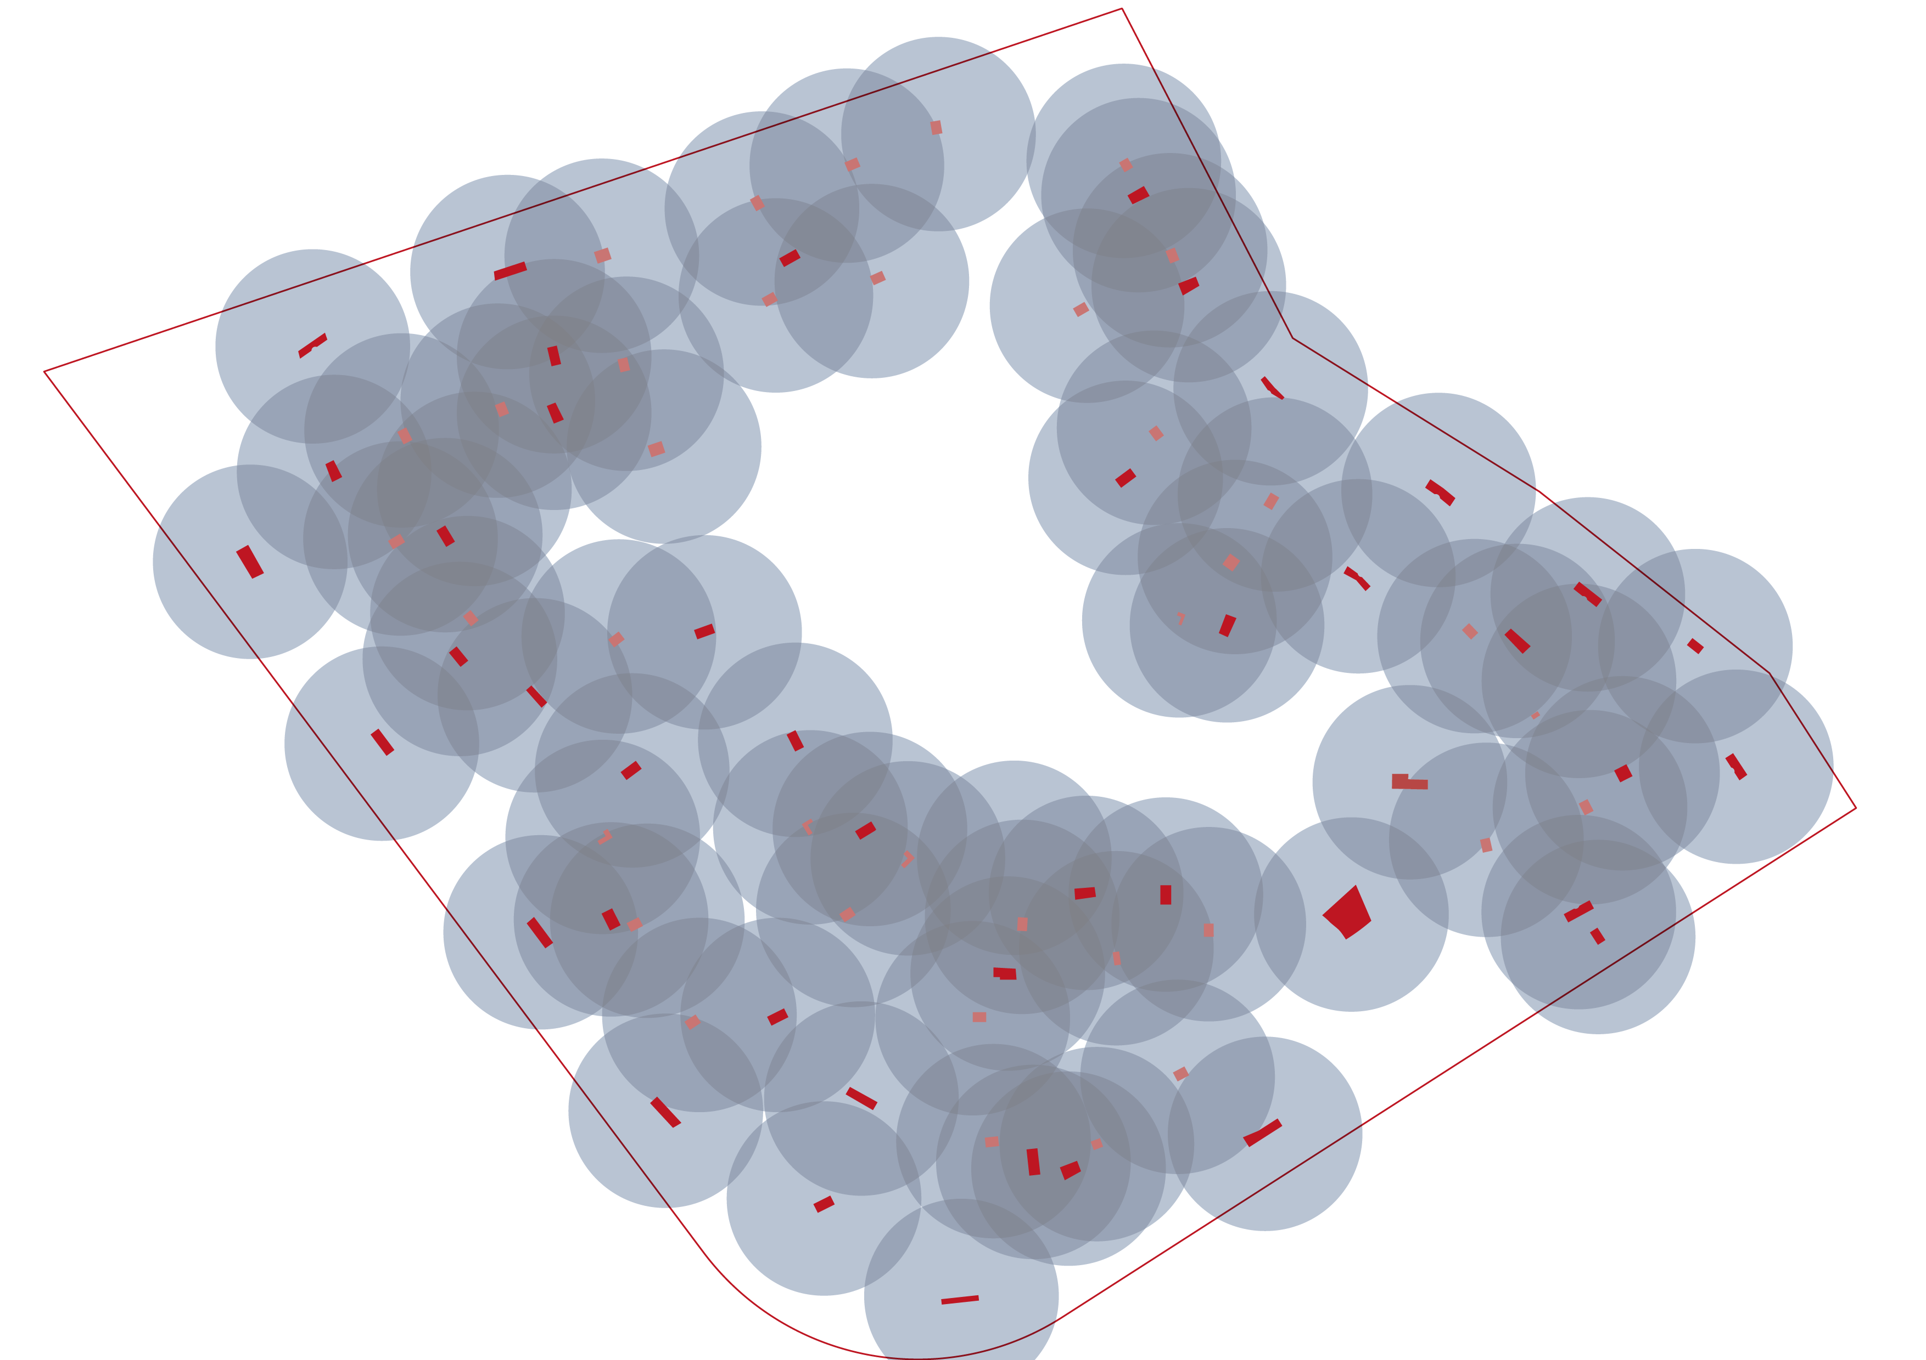
05 Masterplan Development
Special Use Areas – 5 min walk to local centres
Neighbourhood Centres
The neighbourhood centres are strategically placed within each residential cluster.
They contain uses such as nurseries, gyms, small shops and neighbourhood cafés as well as facility/compound management offices.
>90% of all residential units are within a 5 min walking distance of a local centre.

Slide 22
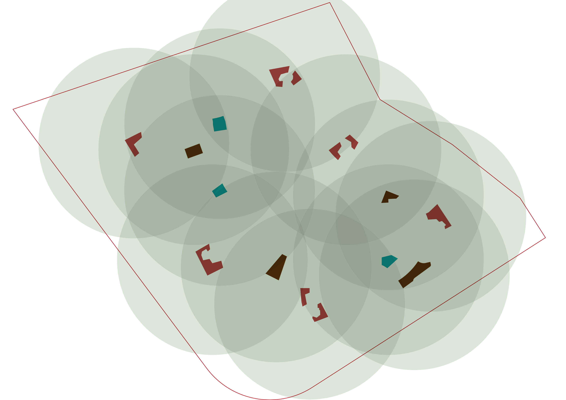
05 Masterplan Development
Special Use Areas - 10 min cycling distance
10 min cycling distance
Facilities such as district centres, international schools and places of worship can be reached from over 95% of the residents within under 10 minutes by bike.
Throughout the entire development, e-bike charging and rental stations ensure a maximum comfort when using the bicycle as mean of transportation.
05.05.2018
– 6th of October Badya
22

Slide 23
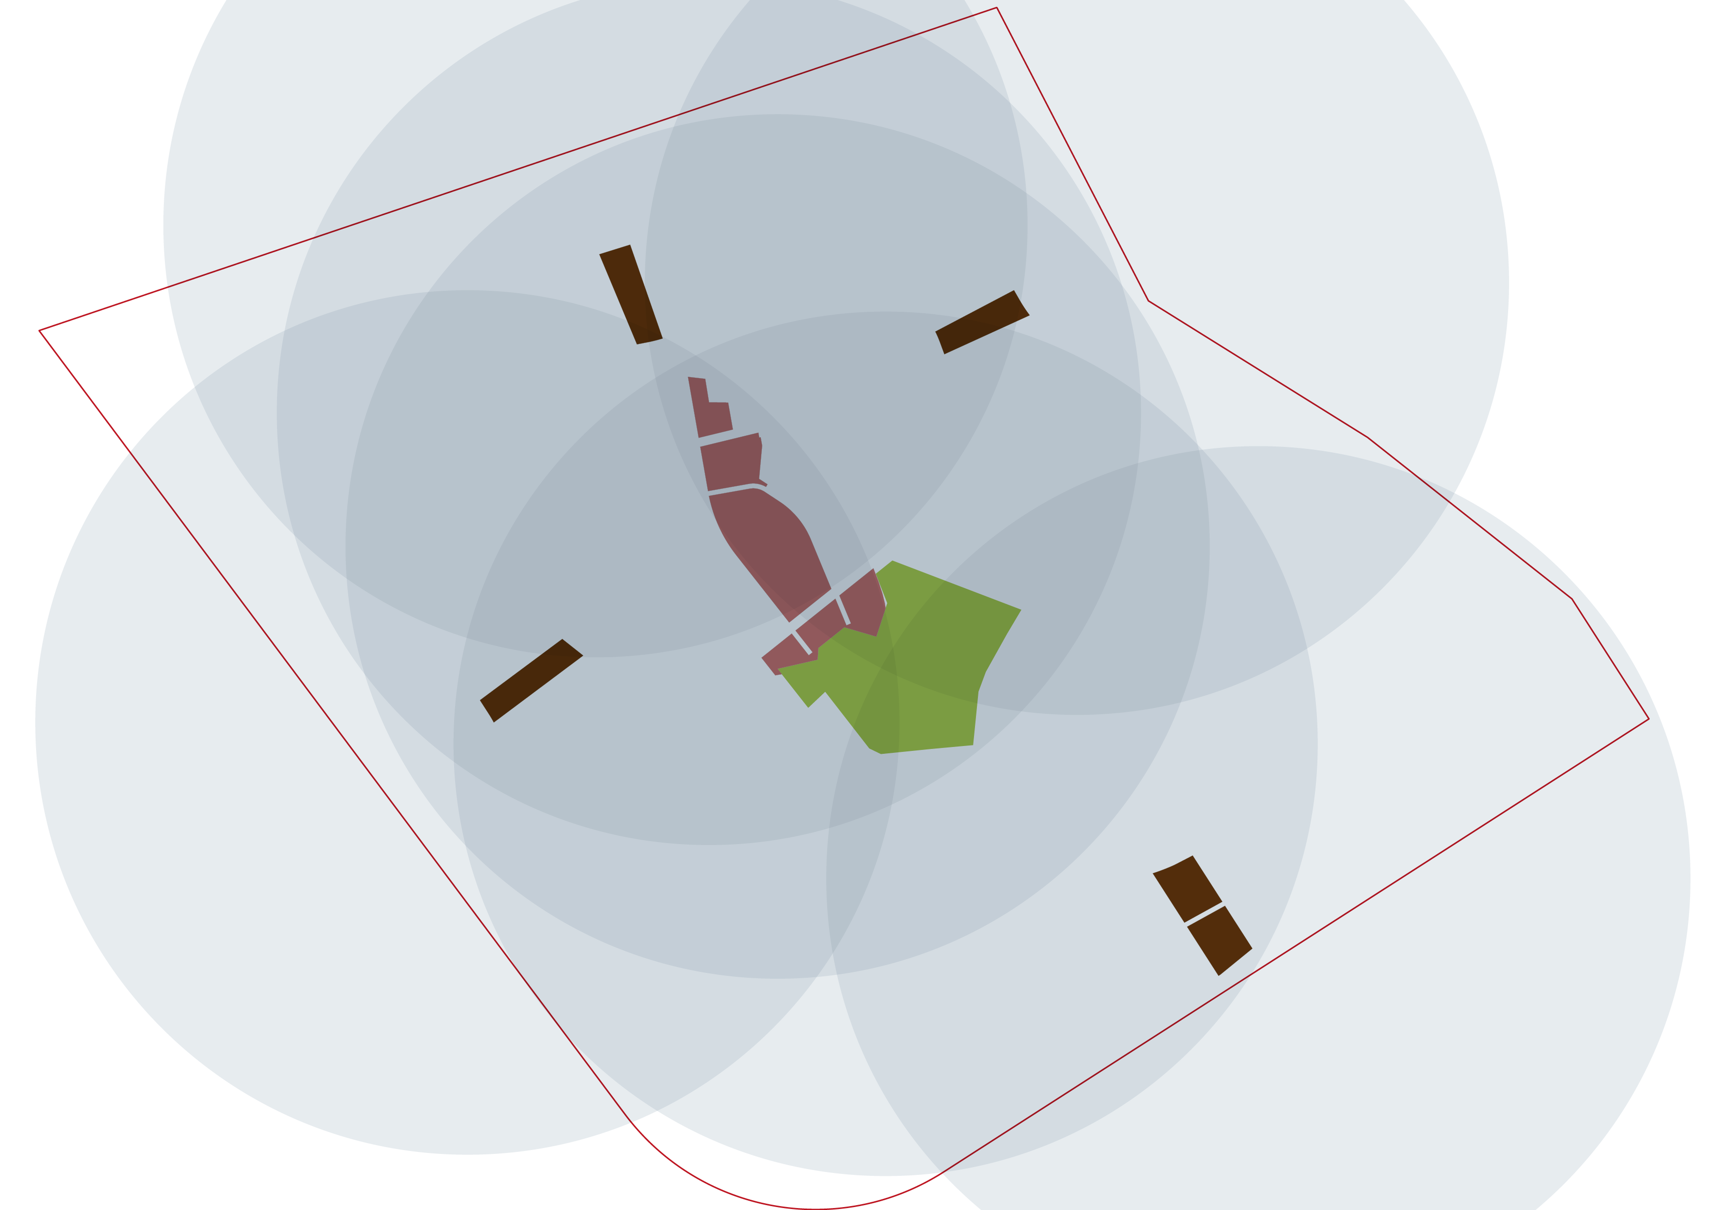
05 Masterplan Development
Special Use Areas - 15 min cycling distance
15 min cycling distance
Facilities such as district centres, international schools and places of worship can be reached from over 95% of the residents within under 10 minutes by bike.
Throughout the entire development, e-bike charging and rental stations ensure a maximum comfort when using the bicycle as mean of transportation.
05.05.2018
– 6th of October Badya
23

